Slide 1
Stabilizing Housing In An Unstable World:
What Recent Moratoriums on Evictions/Foreclosures Mean for Lowcountry Residents
PRESENTED BY

Slide 2
Zoom Meeting House Keeping:
All participants are muted
The video feature has been disabled
Please keep everything CORDIAL, including the comments. We are here to help get some of your questions answered, so PLEASE be nice to us! Those that post inappropriate comments will be removed from this meeting and will not be allowed to return.
There will be polling questions asked. Please know the responses are anonymous. The answers will help us customize the presentation for this audience.
There is time allotted to ask the panelists GENERAL questions. During these times, you can type in questions you would like answered by clicking on the “Chat” button and typing in your question.
A link to this meeting’s recording, and FAQ’s created from the questions we are unable to answer today will be posted on United Way’s website: https://uwlowcountry.org/
A complete copy of this presentation will also be posted, so don’t feel the need to scribble furiously, jotting down notes and links. It will all be posted on our website ☺

Slide 3
Anne Caywood Executive Attorney
A Lowcountry resident since 2011
Serving as Executive Attorney for Lowcountry Legal Volunteers since 2015 and prior to that practiced locally and in North Carolina since 2001 as a litigator
Lowcountry Legal Volunteers normally has 2 fulltime attorneys and at least 15 retired attorneys bringing hundreds of years of combined legal experience to serve the Community
Last year LCLV provided the equivalent of over $2,000,000.00 in legal services to the Community
Anne lives in the Lowcountry with her husband, son and dog Lila
https://lowcountrylegalvolunteers.org

Slide 4
Angela Childers Executive Director
Angela began her career with the Housing Authority in 1998 and obtained her current position as the Executive Director in 2012.
Throughout her career she has served on numerous local, state and regional Boards and Professional Associations including as a member of the Federal Home Loan Bank of Atlanta Affordable Housing Committee, Past President of Carolinas Council of Housing Redevelopment & Codes Officials and as the South Carolina State Representative for the South Eastern Regional Conference of the National Association of Housing & Redevelopment Officials (SERC-NAHRO).
She is President of the SC Association of Housing Authority Executive Directors and a member of the COSY Board.
She is a strong advocate for affordable housing, children and families believing that every community is responsible for its elderly, disabled and children.
https://BeaufortHA.com

Slide 5
Amber Hewitt Manger of Community Impact
Born and raised in Columbiana County, Ohio. She moved to Florida and eventually made her way to Beaufort nearly 14 years ago.
She began working at United Way of the Lowcountry two years ago and is now the Manager of Community Impact. Prior to working for United Way, she worked for 16 years at Salvation Army as the Director of Thrift Store Operations as well as the Director of Social Services.
Aside from her work at United Way, she actively volunteers in the community whenever she can, most recently helping to achieve a Guinness World record for the most Pink Flamingo’s in a line at Fripp Island’s Pledge the Pink Breast Cancer Awareness event as well as helping at The Giving to provide Thanksgiving meals for those in need.
Amber is a Wife, Mother and Nana to her two young grandchildren. She is passionate about helping others and taking photographs of the beautiful Lowcountry.
https://uwlowcountry.org/

Slide 6
Chrystie Turner Vice President – Community Impact
Lived in the Lowcountry for 19 years, before that I lived “up North” and was a criminologist for the Baltimore City Police Department
Been with United Way of the Lowcountry 17 years
Responsibilities include overseeing the grants process that provides operational funding to local non-profits and the administration of United Way’s two county HELPLINE, which links local residents up with the resources that can assist
Sit on several local Boards and have served as a presenter for numerous trainings that focus on the needs of non-profit organizations, as well as breaking the cycle of poverty
Nationally certified Information and Referral Specialist by Alliance of Information & Referral Systems
Certified Trainer for “Bridges Out of Poverty” matrix
A PROUD Leadership Beaufort Alumni
https://uwlowcountry.org/

Slide 7
Description:
The ever-shifting housing landscape produced by well meaning moratoriums have resulted in residents having many more housing questions than they have housing answers.
If you count yourself as one of the thousands in the Lowcountry who are confused about what these moratoriums mean to them, this Zoom meeting is for YOU! We will be addressing:
Landlord / Tenant Law in SC
What the legal process is for evictions and foreclosures
How do you know if you’re eligible for protection under the moratorium?
FAQ’s – Asked and Answered
Who can you go to for Help?

Slide 8
Polling Question…

Slide 9
Landlord/Tenant Law in South Carolina
The South Carolina Residential Landlord Tenant Act applies to a rental agreement for a personal residence.
Most landlord tenant disputes have to do with the nonpayment of rent or failure by a tenant or a landlord to maintain the rental unit.
Failure by a landlord or tenant to comply with the rental agreement or the South Carolina Residential Landlord Tenant Act, gives the landlord or tenant a right to file a claim with the magistrate's court.

Slide 10
Landlord/Tenant Law in South Carolina
The Residential Landlord Tenant Act defines the obligations of the landlord and tenant with respect to security deposits, maintenance of the rental, the right to enter the rental, as well as the obligation to provide essential services to the tenant, among other things.
A landlord or tenant may, in certain cases, recover money damages and attorney fees in the event of a violation of the rental agreement or the Landlord-Tenant Act.

Slide 11
Landlord/Tenant Law in South Carolina
After a lease has been terminated, if the tenant refuses to move out, the landlord can seek an Order of eviction in Magistrates Court.
The tenant must receive proper notice of the proceedings and a hearing.
The Magistrate issues the written Eviction Order requiring the tenant to either move out or explain to the Magistrate within 10 days after service of the Order why they should not be evicted.
If no tenant can be found in possession of the rental unit for a period of 15 days or more, a copy of the Order may be served by posting it on the most noticeable part of the rental unit or premises.

Slide 12
Landlord/Tenant Law in South Carolina
The tenant/renter has a right to file a claim in Magistrates Court If the landlord unlawfully removes or prohibits the tenant from occupying the dwelling unit, willfully causes interruption of basic services, like water, electricity and heating.
The tenant may request possession of the rental or may choose to terminate the rental agreement. In these cases, the tenant may be able to recover an amount equal to three months rent or twice the actual damages suffered by him, whichever is greater, plus reasonable attorney's fees.
If the rental agreement is terminated by the renter they are also entitled to the return of their security deposit.

Slide 13
Landlord/Tenant Law in South Carolina
An unlawful entry into the tenant's dwelling unit by the landlord and/or repeated lawful entries, repeated demands for entry and harassment of the tenant may entitle the tenant may seek an order against the landlord in Magistrates or Circuit Court to prevent the behavior from continuing, or to terminate the rental agreement.
The tenant/renter may recover actual damages and reasonable attorney's fees.

Slide 14
Landlord/Tenant Law in South Carolina
If the tenant notifies the Magistrate that they contest the eviction, a hearing will be held.
The tenant is entitled to a trial by jury if requested. If the landlord wins, the Magistrate will issue an Order of ejectment within 5 days. At this point the tenant shall be ejected by a Deputy Sheriff of the County.
The tenant is given the opportunity to vacate voluntarily but if they refuse to vacate or the rental appears unoccupied, the Deputy Sheriff may then enter the rental unit by force to eject the tenant.
The Deputy Sheriff uses their best judgment in delaying the removal of ill or elderly tenants.

Slide 15
Generally, a landlord may evict a tenant and take possession of the rental unit for any one of the following reasons:
Nonpayment of Rent
Breach of the terms of the rental agreement (verbal or written)
Failure of tenant to maintain the dwelling unit in a healthy and safe manner
Abandonment of the rental unit by the tenant
When the lease term has ended

Slide 16
1. Nonpayment of rent
\
If rent is not paid when due, the landlord has the right to end the rental agreement and start eviction proceedings after giving 5 days written notice, and if no rent is paid within that time. BUT the landlord only has to give written notice that the rent is past due one time during the lease term.
However, no notice is required if the rental agreement, or lease, is in writing and states expressly that no written notice will be given if rent is past due.

Slide 17
2. Breach of the terms of the rental agreement (verbal or written)
If the tenant violates the terms of the rental agreement in other ways, the landlord may also terminate the rental agreement and begin eviction proceedings. The landlord must give written notice specifying how the tenant violated the rental agreement. The tenant has 14 days to correct or stop this violation or eviction proceedings can begin and the landlord can terminate the rental agreement.

Slide 18
3. Failure of tenant to maintain the dwelling unit in a healthy and safe manner
The landlord has the right to terminate the rental agreement and start eviction proceedings if the tenant does not properly take care of the dwelling unit to the extent health and safety is endangered by the tenant’s lack of maintenance.
If it is not an emergency situation--then the tenant the has 14 days from the date of notice to fix the problem and eviction proceedings can begin

Slide 19
4. Abandonment of the rental unit by the tenant
15 days after the rent was due and not paid and after the landlord discovers what appears to be an abandoned rental unit, the the landlord can take possession.
This is not an eviction. The landlord may consider the rental agreement terminated or to still be in effect, in which case the landlord must try to rent the unit at fair market price.
If the unit is rented before the end of the rental agreement, then tenant's responsibility ends as soon as the new rental agreement is in place with the new renter.

Slide 20
5. When the lease term has ended
The most natural way a lease ends is that the lease term of the rental agreement has ended.
If the tenant refuses to move out after the end of the lease term the landlord may bring an action in court to evict the tenant.

Slide 21
Landlord/Tenant Law in South Carolina
If there is no defined term in a rental agreement, the landlord may end the rental agreement.
If a tenant pays weekly rent, then the Landlord may demand that the tenant move out only after giving the tenant 7 days written notice.
Otherwise where there is no definite rental term, the landlord is required to give at least 30 days written notice to the renter to move out.

Slide 22
Landlord/Tenant Law in South Carolina
After the rental agreement is terminated the landlord has a right to possession of the rental unit and rent.
The Landlord has the right to bring a separate claim for damages for breach of the rental agreement and may recover reasonable attorney's fees.

Slide 23
Landlord/Tenant Law in South Carolina
CDC’s temporary eviction moratorium
To prevent the further spread of the coronavirus, the Centers for Disease Control and Prevention (CDC) has issued an order to temporarily halt certain residential evictions for nonpayment of rent. To qualify for the protection, you will need to meet certain eligibility requirements .
Unless the CDC order is extended, changed, or ended, if you meet certain conditions and provide a sworn declaration, the order prevents you from being evicted or removed from where you are living through December 31, 2020.

Slide 24
Landlord/Tenant Law in South Carolina – CDC Moratorium
The order is effective as of September 4, 2020.
You must complete a declaration stating that you meet the specific eligibility requirements.
Information on the declaration form notes: “This declaration is sworn testimony, meaning that you can be prosecuted, go to jail, or pay a fine if you lie, mislead, or omit important information.”
Each adult listed on the lease, rental agreement, or housing contract should complete this declaration.
You are still required to pay rent and follow all the other terms of your lease and rules of the place where you live.
You can still be evicted for other reasons, such as violating your lease or the rules of the place where you live.
The order does not include foreclosures on home mortgages

Slide 25
South Carolina Foreclosure Procedures Require a CARES Act Certification
In South Carolina, the foreclosing party must file a specific form certifying its compliance with the Coronavirus Aid, Relief, and Economic Security (CARES) Act in court as part of the official foreclosure procedures
On August 27, 2020, the Federal Housing Administration (FHA) published Mortgagee Letter (ML) 2020-27, “Extension of Foreclosure and Eviction Moratorium in Connection with the Presidentially-Declared COVID-19 National Emergency,” which announces a third extension of the foreclosure and eviction moratorium through December 31, 2020.
This moratorium extension is effective immediately upon the expiration of the existing moratorium announced in ML 2020-19. This guidance is applicable to all FHA Title II single family forward mortgage and Home Equity Conversion Mortgage (HECM) reverse mortgage programs, except for those secured by vacant and/or abandoned properties.

Slide 26
Mortgage/Foreclosure in South Carolina
If you’re having trouble making your mortgage payments and worried you might go through a foreclosure in South Carolina
It is important that you learn about the process and your rights.
Federal and state laws set forth the foreclosure process.
Lenders and servicers can make procedural mistakes and violate the law when processing foreclosures.
This may provide the homeowner with a legal defense if either the servicer or lender has violated the law in some way.

Slide 27
Federal Foreclosure Laws
Federal mortgage servicing laws give various protections to homeowners both before and during the foreclosure process, including:
the servicer (on behalf of the lender) must attempt to contact the homeowner to discuss the situation no later than 36 days after the homeowner misses a payment, and again within 36 days after each subsequent delinquency
no later than 45 days after a missed payment, the servicer must inform the homeowner in writing about loss mitigation (foreclosure alternative) options that might be available, and
a foreclosure generally can’t start until the homeowner is more than 120 days delinquent on the payments.

Slide 28
South Carolina Foreclosure Process
Foreclosures in South Carolina are handled through the Courts
A lender must file a lawsuit to foreclose the home
In some South Carolina counties, foreclosures go through an equity court judge or with a special referee

Slide 29
South Carolina Foreclosure Procedures
Homeowners can expect if they stop making their mortgage payments in South Carolina that they will face a foreclosure
Notice is require and usually what is called a Breach Letter is required.\
South Carolina doesn’t require the lender to send a notice to the homeowner before filing a foreclosure lawsuit.
Most mortgages contain language requiring the lender to send the homeowner a letter- before starting a foreclosure.
Read your loan documents to find out what notices you're entitled to get

Slide 30
Complaint, Service, and Summons
120 days after the delinquency date and after any notice periods required by the mortgage itself, the lender begins the lawsuit by filing what is called a“complaint,” with the court.

Slide 31
Mortgage/Foreclosure in South Carolina
A complaint for foreclosure it must be served on the homeowner, together with a summons.
A summons tells the homeowner what relief is being requested by the lender the location of the court where the case is filed and contact information for the lender’s attorney
An answer must be filed detailing the homeowner’s response must be filed within 30 days service.

Slide 32
Foreclosure Intervention
Notice must be given to ensure homeowners get the opportunity to discuss and negotiate potential alternatives to foreclosure.
The South Carolina Supreme Court issued an administrative order requiring lenders to serve homeowners with notice of the right to foreclosure intervention.
Within 30 days from service of the notice foreclosure intervention the homeowner must request a hearing or the foreclosure case may proceed.

Slide 33
Foreclosure Intervention
Foreclosure intervention provides a good opportunity to discuss a possible resolution
Homeowners should take advantage of this opportunity to modify their loan or negotiate a resolution with their lender
It is helpful to seek legal advice in dealing with these matters

Slide 34
Foreclosure Hearing and Judgment
If the homeowner files an answer, a foreclosure hearing will be held to determine the validity of the foreclosure.
If at the hearing, the court determines that the foreclosure is proper, it will enter a judgment against the homeowner.
However, If the homeowner doesn’t file an answer, the lender will win the case and get a judgment against the homeowner in the foreclosure case.

Slide 35
Redemption
Before the sale, the homeowner has the right to pay off the entire debt and stop the sale from happening, which is called the right of “redemption.”

Slide 36
Foreclosure Sale
Post judgment, a public auction of the home is scheduled.
Notice of the sale must be posted in three public places in the county, including the courthouse.
Notice must also be published in a local newspaper once a week for three consecutive weeks prior to the sale.
The auction will be conducted by a master-in-equity, referee, or sheriff and is normally at the courthouse in the county where the property is located.

Slide 37
After the Sale
Proceeds/money from the sale are applied to the homeowner’s mortgage debt.
If the proceeds exceed the total amount owed, the homeowner is entitled to the excess, assuming there aren't other debts owed as liens on the property.
If the proceeds fail to completely satisfy the amount owed, the lender may seek what is called a deficiency judgment against the homeowner.

Slide 38
Mortgage/Foreclosure in South Carolina
The lender may reserve the right to seek a deficiency judgment
If they do, the bidding remains open for an additional 30 days after the foreclosure sale.
Many lenders waive their right to a deficiency judgment to avoid this delay
After the sale or after 30 days if a deficiency judgment is sought, the homeowner must vacate the property or be evicted

Slide 39
Talk to an Attorney
If you’re facing a foreclosure in South Carolina, having a general understanding of the laws and process can provide you some level of comfort.
If you would like to read South Carolina’s foreclosure laws for you can go to Title 29, Chapter 3, Article 7; Title 15, Chapter 39, Article 5; and Title 15, Chapter 29 of the South Carolina Code of Laws.
However, getting an attorney to assist you is the best course of action to protect your legal rights

Slide 40
Polling Question…

Slide 41
FAQ’s
Frequently Asked Questions

Slide 42
Renters
How do I know if I am eligible for protection under the Moratorium?
The Moratorium applies to evictions due to nonpayment of rent, fees or utility service charges payable to the landlord. Nonpayment of rent does not have to be due to wage loss resulting from COVID-19.
The Coronavirus Aid, Relief, and Economic Security (CARES) Act imposed a federal moratorium, which is a temporary suspension on evictions and foreclosure procedures. It basically prohibited property owners from both filing new evictions against tenants for not paying rent and charging additional fees because of non-payment. The federal moratorium expired on July 24, 2020, allowing landlords to issue a 30-day notice for tenants to vacate properties.
In response to the COVID-19 crisis, the Supreme Court of South Carolina issued a temporary moratorium on evictions and foreclosures, which requires any party pursuing an eviction or foreclosure in a trial court to submit to the court a signed, original Certification of Compliance with the CARES Act. The State moratorium was lifted recently and Landlords can resume sending out eviction notices to Tenants.

Slide 43
Renters
I've never been in an eviction situation, what should I do if I cannot pay rent?
- Seek Government Assistance such as TANF
- Seek rental assistance through a South Carolina Agency
- Seek legal advice to see what remedies are available.
- Talk to your landlord to see if you can get an extension on payment of the rent.

Slide 44
Renters
What is the process for an eviction?
Under South Carolina law, a landlord may evict a tenant and take possession of the rental unit for any one of the following reasons: (1) failure to pay rent, (2) breach of the terms of the rental agreement (verbal or written), (3) failure of tenant to maintain the dwelling unit in a healthy and safe manner, (4) abandonment of the rental unit by the tenant, or (5) then the lease term has ended.
Source: https://www.scbar.org/public/get-legal-help/common-legal-topics/eviction/
For residential rental agreements, nonpayment of rent within five days of the due date constitutes legal notice to the tenant that the landlord has the right to begin ejectment proceedings. South Carolina Code Section 27-37-10 requires the landlord to provide a five-day notice to pay rent. If the landlord includes a 5-day due date in the lease, then no other notice is required as long as you live in the rental unit. For violations of the lease other than nonpayment of rent, the landlord must provide a fourteen (14) day notice to cure.
Source: https://www.burr.com/2020/07/30/south-carolina-moratorium-on-evictions-and-foreclosures-due-to-covid-19/

Slide 45
Renters
What is the process for an eviction? (Cont.)
Once the required notice period has expired, if applicable, the landlord may submit application to any magistrate having jurisdiction for the issuance of a written rule requiring tenant to vacate the premises or show cause why the tenant should not be ejected before the magistrate within ten (10) days after service of a copy of the rule.
Source: https://www.burr.com/2020/07/30/south-carolina-moratorium-on-evictions-and-foreclosures-due-to-covid-19/
According to South Carolina Code Section 27-37-150, acceptance by the landlord of any rent (partial or full), whether it shall have accrued at the time of issuing the ejectment ruling or subsequently accrues, does not operate as a waiver of the landlord’s right to insist upon ejectment, nor as a renewal or extension of the tenancy.
Source: https://www.burr.com/2020/07/30/south-carolina-moratorium-on-evictions-and-foreclosures-due-to-covid-19/

Slide 46
Renters
What is the process for an eviction? (Cont.)
South Carolina allows collection of rent by distraint. According to South Carolina Code Section 27-39-210, a landlord may apply to a magistrate with jurisdiction for the seizure and sale of tenant property to satisfy past due rent. Satisfaction of rent by distress or distraint are considered extraordinary remedies and only apply to past due rent and cannot be used to satisfy an acceleration clause in a lease.
Source: https://www.burr.com/2020/07/30/south-carolina-moratorium-on-evictions-and-foreclosures-due-to-covid-19/

Slide 47
Renters
Should I get legal help? Which cases should consider reaching out?
Yes, if you have been or are in the process of being evicted then you should seek legal assistance. Most, if not all cases, require legal assistance, even if it is just to negotiate a better deal.

Slide 48
Renters
Does the landlord's mortgage affect whether renters can be evicted? And if so, how can I get that information?
Yes, the landlord's mortgage can affect whether renters can be evicted. If your landlord is getting CARES Act relief from mortgage payments on your home, then you may be protected from eviction for a longer period.
Source: https://www.consumerfinance.gov/coronavirus/mortgage-and-housing-assistance/renter-protections/

Slide 49
Renters
Are the courts open for business? If yes, how long does the process take?
Yes, some courts are open for business and the time frame of the court process varies depending on the case type and the scheduling of the hearing. On July 30, 2020, the Supreme Court of South Carolina Court imposed operations during the Seven-Week Period from August 3 – September 18, 2020. Chief Justice Donald W. Beatty decided that status conferences, pre-trial matters and scheduled hearings may be conducted using remote communication technology to avoid the need for a physical appearance of all or some of the parties, counsel or witnesses. Consent of the parties or counsel is not required. Video conferencing should be the primary means of holding hearings. In-person hearings should occur only when remote hearings are not feasible.
Source: https://www.sccourts.org/coronavirus/LocalOrders/August3September18Memo.pdf

Slide 50
Renters
There's a pandemic, do I still have to show up in court if my landlord files an eviction?
It depends on when the Landlord filed the eviction. From March 27 to July 24, 2020, if your landlord filed an eviction then you are protected under the CARES Act under moratorium and the State of South Carolina moratorium in response to the CARES Act.
Sources: https://www.sccourts.org/coronavirus/LocalOrders/August3September18Memo.pdf
https://www.consumerfinance.gov/coronavirus/mortgage-and-housing-assistance/renter-protections/

Slide 51
Renters
Do I owe the rent payments if I missed during the moratorium?
Yes. Even if the CARES Act eviction moratorium or a state or local eviction moratorium applies to you, rent payments are still due on the usual date. If you can, continue to pay your rent to avoid eviction in the future.
Source: https://www.consumerfinance.gov/coronavirus/mortgage-and-housing-assistance/renter-protections/

Slide 52
Renters
Does the eviction moratorium prevent my landlord from charging late fees if I haven't paid my rent in full?
Yes. Under the CARES Act moratorium, landlords or housing authorities may not charge fees, penalties, or other charges related to nonpayment between the months of April – July 31st.
Source: https://www.consumerfinance.gov/coronavirus/mortgage-and-housing-assistance/renter-protections/

Slide 53
Renters
If I was behind in my rent before March 25th, does the eviction moratorium apply to me?
In this situation, you might still receive eviction protection offered by your state or local jurisdiction. However, the CARES Act Moratorium along with the South Carolina Moratorium only applies to evictions that occurred after March 27, 2020.
Source: https://www.consumerfinance.gov/coronavirus/mortgage-and-housing-assistance/renter-protections/

Slide 54
Renters
What happens if my lease ends while the moratorium is in place? Can they penalize me by using my rental history as a reason not to renew? What if I don't have a current lease? Or a written lease?
If your lease ends while the moratorium is in place, then you have the option to renew your lease. However, you do not have to renew the lease if your lease ends while the moratorium is in place. Landlords should not use a tenant's recent rental history to determine whether or not a tenant shall renew a lease. However, if you do not have a current lease or a written lease then you are protected during the moratorium period from eviction, but your tenancy status will change depending on the situation -- such as, holdover tenant and you will be accountable for the rent due.

Slide 55
Renters
Who do I contact for more information about eviction protection?
Contact:
Lowcountry Legal Volunteers - https://lowcountrylegalvolunteers.org/
(843) 815-1570
SC Legal Services - https://sclegal.org/
(843) 720-7044
SC Pro Bono, SC Lawyer Referral Services - https://charlestonprobono.org/
(843) 853-6456
SCVAN - http://www.scvan.org/
(803) 750-1200

Slide 56
Renters
Will there be more federal help for renters?
MAYBE
there possibly could be more federal assistance for renters during the COVID-19 Pandemic. President Trump did impose an Executive Order in response to providing assistance to renters and homeowners.
Source: https://www.whitehouse.gov/presidential-actions/executive-order-fighting-spread-covid-19-providing-assistance-renters-homeowners/
According to the recent Executive Order, President Trump's order includes the following language in response to federal assistance for renters.

Slide 57
Renters
The Secretary of the Treasury and the Secretary of Housing and Urban Development shall identify any and all available Federal funds to provide temporary financial assistance to renters and homeowners who, as a result of the financial hardships caused by COVID-19, are struggling to meet their monthly rental or mortgage obligations.
(c) The Secretary of Housing and Urban Development shall take action, as appropriate and consistent with applicable law, to promote the ability of renters and homeowners to avoid eviction or foreclosure resulting from financial hardships caused by COVID-19.
Such action may include encouraging and providing assistance to public housing authorities, affordable housing owners, landlords, and recipients of Federal grant funds in minimizing evictions and foreclosures.

Slide 58
Renters
Maintenance: My Landlord is changing filters monthly, do I have to let them in during this pandemic?
It depends. Normally, the Landlord pursuant to the lease may need access to maintain the rental. In this example, if the tenant is able to do so, an agreement may be reached for the tenant to change the filters due to the pandemic.
My Household is under quarantine, do I have to let maintenance inside to do work?
It depends. Normally, the Landlord pursuant to lease has the right by statute to maintain the rental. For example, if the rental was flooding it would be more likely that access would need to be granted.

Slide 59
Renters
15. My Landlord is not making repairs. How long should I wait before contacting someone to help me?
If there are repairs to be made it is a best practice to notify the Landlord in writing a demand for these repairs to be made. Depending on the nature of the repair needed, the Landlord generally has a reasonable amount of time to make the repair after being notified by the Tenant.

Slide 60
Landlords
1. Does the moratorium protect against evictions due to foreclosures?
No. The moratorium is intended to protect Tenants NOT Landlords from evictions due to foreclosures for the period of March 27, 2020 to July 24, 2020.
Source: https://www.usa.gov/disaster-help-food-housing-bills#item-214619
The CARES Act included a 120-day federal eviction moratorium for renters who participate in federal housing assistance programs or live in a property with a federally backed mortgage. [5] The moratorium prohibited owners of the defined properties from both filing new evictions against tenants for not paying rent and charging additional fees because of non-payment. This ban expired on July 24, allowing landlords to issue 30 days’ notice for tenants to vacate properties.
Source: https://www.cbpp.org/research/housing/extend-cares-act-eviction-moratorium-combine-with-rental-assistance-to-promote

Slide 61
Landlords
How do I know if I'm eligible for protection under the moratorium?
An eviction moratorium on most federally-backed rental housing ended on July 24, 2020. Now, after the 30 period, landlords can send out written notices to vacate for eviction for nonpayment. The Federal Housing Finance Agency offers mortgage forbearance to multifamily property owners on the condition they suspend all evictions.
Source: https://www.avail.co/education/articles/how-are-landlords-responding-to-covid-19
Impacted landlords can also apply for a line of credit or a Small Business Administration (SBA) Disaster Loan.
Source: https://www.avail.co/education/articles/how-are-landlords-responding-to-covid-19
Landlords and tenants can enter into a repayment plan to avoid eviction.
Source: https://www.usa.gov/disaster-help-food-housing-bills

Slide 62
Renters
Who do I contact for more information about eviction protection?
Contact:
Lowcountry Legal Volunteers - https://lowcountrylegalvolunteers.org/
(843) 815-1570
SC Legal Services - https://sclegal.org/
(843) 720-7044
SC Pro Bono, SC Lawyer Referral Services - https://charlestonprobono.org/
(843) 853-6456
SCVAN - http://www.scvan.org/
(803) 750-1200

Slide 63
Landlords
Are there Financial Assistance Programs for landlords who suffer a loss of income as a result of tenants' inability to pay rent?
Yes, landlords should check to see if they qualify for temporary rental relief for many affected by the Coronavirus Pandemic.
https://www.usa.gov/disaster-help-food-housing-bills

Slide 64
Landlords
Who can I reach out to for direct financial assistance to pay my mortgage?
Landlords can receive forbearance, or relief, on their federally-backed mortgages.
Source: https://www.usa.gov/disaster-help-food-housing-bills
The forbearance extension is available for qualified properties/Landlords experiencing a financial hardship due to the coronavirus national emergency. If a forbearance is extended, once the forbearance period concludes the borrower may qualify for up to 24 months to repay the missed payments. Additionally, if the forbearance is extended, the repayment schedule is modified, or a new forbearance agreement is executed, the borrower is required to provide the following tenant protections during the repayment period.
Source: https://www.fhfa.gov/Media/PublicAffairs/Pages/FHFA-Provides-Tenant-Protections.aspx

Slide 65
Landlords
Will there be more federal help for landlords?
Yes, there possibly could be more federal assistance for landlords during the COVID-19 Pandemic. President Trump did impose an Executive Order in response to providing assistance to renters and homeowners.
Source: https://www.whitehouse.gov/presidential-actions/executive-order-fighting-spread-covid-19-providing-assistance-renters-homeowners/
The Secretary of the Treasury and the Secretary of Housing and Urban Development shall identify any and all available Federal funds to provide temporary financial assistance to renters and homeowners who, as a result of the financial hardships caused by COVID-19, are struggling to meet their monthly rental or mortgage obligations.
https://www.whitehouse.gov/presidential-actions/executive-order-fighting-spread-covid-19-providing-assistance-renters-homeowners/

Slide 66
Landlords
Will there be more federal help for landlords? (Cont.)
The Secretary of Housing and Urban Development shall take action, as appropriate and consistent with applicable law, to promote the ability of renters and homeowners to avoid eviction or foreclosure resulting from financial hardships caused by COVID-19. Such action may include encouraging and providing assistance to public housing authorities, affordable housing owners, landlords, and recipients of Federal grant funds in minimizing evictions and foreclosures.
https://www.whitehouse.gov/presidential-actions/executive-order-fighting-spread-covid-19-providing-assistance-renters-homeowners/

Slide 67
Polling Question…

Slide 68
Direct Financial Assistance
COVID Response

Slide 69
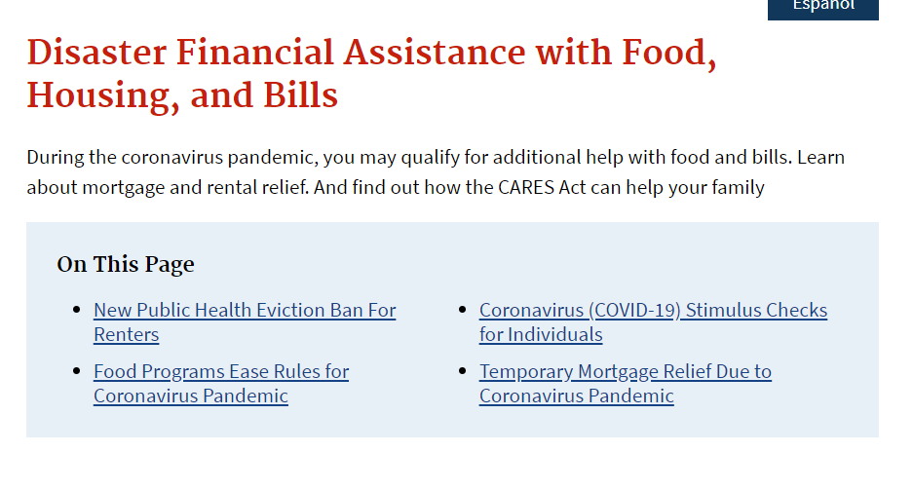
Federal Programs
For direct financial assistance to pay for your rent, you can reach out to the United States Disaster Financial Assistance and see if you qualify for temporary mortgage relief due to the COVID-19 pandemic. For more information, visit the website:
https://www.usa.gov/disaster-help-food-housing-bills#item-214620

Slide 70
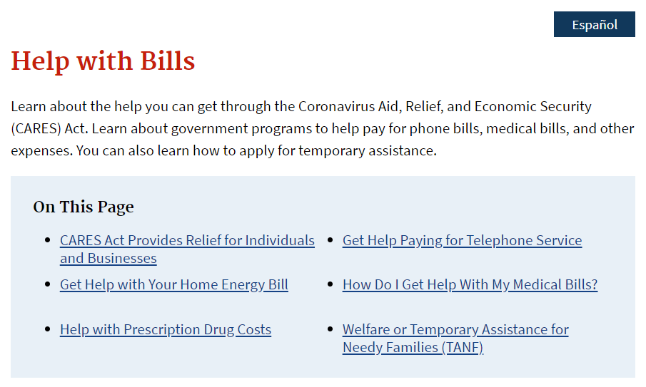
Federal Programs
Also, you can check to see government programs to help pay for home energy bills and other expenses, at
https://www.usa.gov/help-with-bills

Slide 71
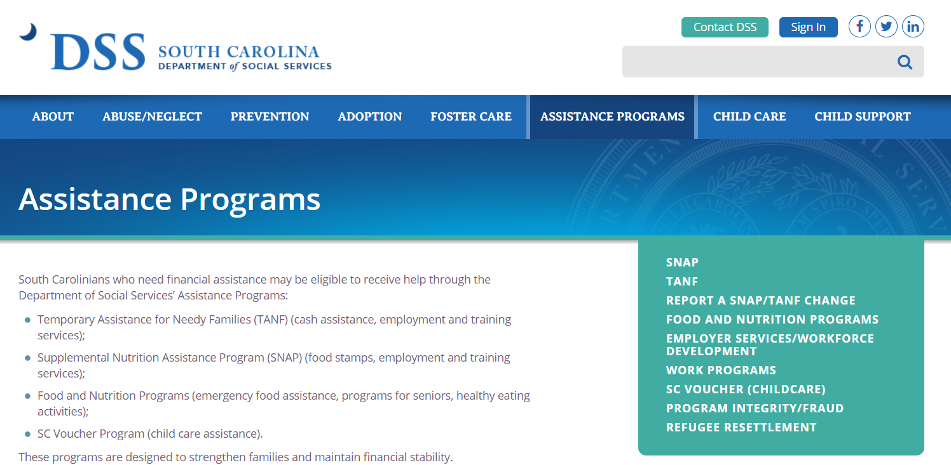
Federal/ State Programs
You can also check to see if you qualify for federal programs such as Family Independence (FI), Temporary Assistance for Needy Families (TANF), or Supplemental Nutritional Assistance Program (SNAP). For more information:
https://dss.sc.gov/contact/low-country-region/beaufort/
Sources:
https://www.usa.gov/disaster-help-food-housing-bills#item-214620
https://www.hud.gov/sites/dfiles/PIH/documents/Attachment2_TenantBrochure.pdf
https://www.usa.gov/help-with-bills

Slide 72
United Way COVID Relief Fund
Created to assist the Lowcountry’s most vulnerable neighbors with the resources they need during this critical time.
United Way of the Lowcountry will distribute 100% of the funds collected to provide services to residents in Beaufort and Jasper Counties to meet basic needs including rent and utility assistance and other necessities due to the loss of income or employment related to the COVID-19 pandemic.
Call (843) 524-4357 to see if you are eligible.

Slide 73
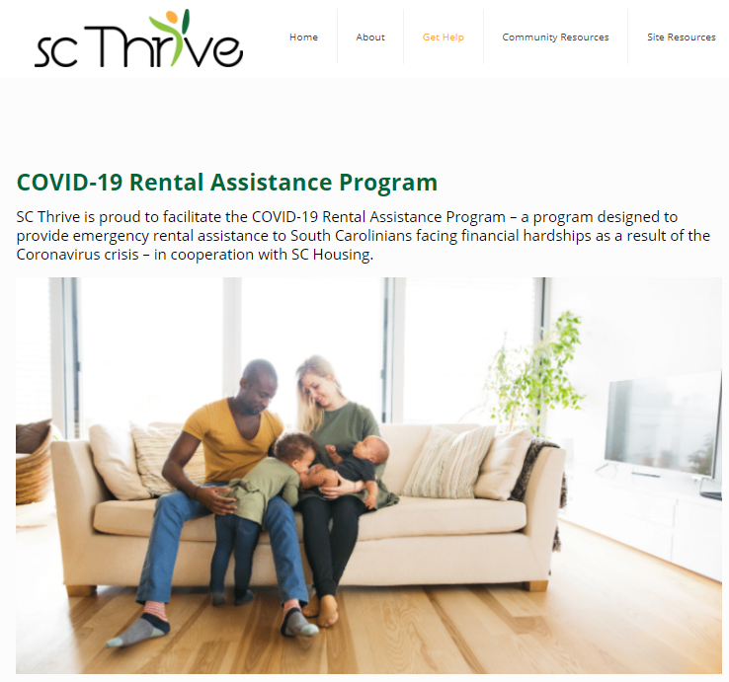
SC Thrive Rental Assistance Program
In an effort to help lessen the outbreak’s economic impacts on state residents, the program will provide emergency assistance to renters affected by shutdowns, closures, layoffs, reduced work hours or unpaid leave due to the COVID-19 health crisis.
Eligible households will receive up to $1,500 for rent in a one-time, lump-sum payment made directly to property owners or management companies.
For an application and more information, visit their website at:
https://scthrive.org/covid-19-rental-assistance-program/

Slide 74
Local Financial Assistance ~ Beaufort, Jasper, Colleton & Hampton Counties
Salvation Army
(843) 524-3727
2505 North Street, Beaufort, SC 29901
Office hours are from 9-12 and 1-3, M-F
Must have Photo ID, Bill and Shut Off Notice
Get Help
If you are in need of support, there are many ways The Salvation Army may be able to help. Please feel free to contact us about the services below:
Food Pantry
Emergency Assistance - Rent and Utilities
Christmas Assistance
Worship
Emergency Disaster Services
Spiritual Help
For more information, visit their website at:
https://www.salvationarmycarolinas.org/beaufort/
Email: BeaufortSC@uss.salvationarmy.org

Slide 75
Local Financial Assistance ~ Beaufort & Jasper Counties
Beaufort – Jasper Equal Opportunity Commission
(843 255-7220 Beaufort / (843) 726-5586 Jasper
OUR SERVICES
Reducing the effects of poverty in Beaufort and Jasper counties by promoting self-sufficiency and economic independence.
Elevating health, education, and economic standards of low-income residents in our services delivery area is our primary focus. We serve as a network for the state’s not-for-profit and related governmental units to address the daily challenges of the disadvantaged in South Carolina
GENERAL EMERGENCY ASSISTANCE PROGRAM (GEAP)
LOW-INCOME ENERGY ASSISTANCE PROGRAM (LIHEAP)
For more information, visit their website at:
https://thebjeoc.org/

Slide 76
Local Financial Assistance ~ Jasper Residents
AGAPE Family Life Center
(843) 784-6008
MISSION STATEMENT: AGAPE FAMILY LIFE CENTER IS COMMITTED TO EMPOWERING INDIVIDUALS, PROMOTING FAMILY EXCELLENCE AND NURTURING BETTER HEALTH AND WELLNESS IN JASPER COUNTY.
We are organized and operated as a non-profit charitable tax-exempt organization. The Board of Directors is comprised of grassroots members representative of the economically and culturally diverse population it serves.
For more information, visit their website at:
https://www.agapeflc.org/

Slide 77
Local Financial Assistance ~ Jasper Residents
Antioch Educational Center
(843) 645-9400
Due to the Coronavirus, AEC will be serving its neighbors online and by phone until further notice. Please contact us at (843) 645-9400 or by email Monday – Saturday 8am – 6pm at kbbrownaec@gmail.com.
Location 7557 W. Main St. P.O. Box 1930 Ridgeland, SC 29936 (843) 645-9400
For more information, visit their website at:
https://antiochedc.org/coronavirus/

Slide 78
Local Financial Assistance ~ Bluffton Residents
Bluffton Self Help
(843) 757-8000
39 Sheridan Park Circle
Bluffton, SC 29910
Bluffton Self Help exists in order to help our neighbors in need of food, clothing, educational and financial assistance, and to provide programs that promote self-worth, dignity and create a pathway to personal success.
Emergency Financial Assistance
We are currently accepting applications for Emergency Financial Assistance online or through a paper application that can be picked up at the office location and returned in a secure box. After you have submitted your application, please email additional required documents to barbara@blufftonselfhelp.org.
Completed applications MUST include required documentation including a copy of the bill being requested to be considered for an interview. Please review the checklist on our website to ensure all items are completed. A staff member or volunteer will call you for an interview within 3-5 business days.
For an application and more information, visit their website at:
https://www.blufftonselfhelp.org/home

Slide 79
Local Financial Assistance ~ Hilton Head Island Residents
Hilton Head Island Deep Well Project
(843) 785-2849
RENT AND UTILITIES:
Financial aid, in the form of rent and/or utility payments, made directly to the provider, is granted on an emergency basis, generally to individuals who have been residents of Hilton Head Island for at least three months, paying their own rent and utilities, before their application.
The process starts with a phone call to our office, with applicants being interviewed by a trained volunteer to determine eligibility. Payments are made directly to the utility or landlord, ensuring the money is spent on the intended purpose. A return to self-sufficiency is the goal.
REQUESTS BECAUSE OF CORONOVIRUS (COVID-19)
OUR OFFICE WILL BE STAFFED BUT WE WILL NOT BE RECEIVING CLIENTS IN THE OFFICE. ANY REQUESTS BEGIN BY CALLING OUR OFFICE MONDAY THRU FRIDAY 9:00 AM TO 5:00 PM
For an application and more information, visit their website at: https://www.deepwellproject.org/

Slide 80
Local Financial Assistance ~ Beaufort Residents (Northern Beaufort County)
HELP of Beaufort
(843) 524-1223
Building healthy communities by providing education, a safety net, and creating opportunities for those most vulnerable.
Emergency Financial Assistance
We are currently accepting applications for Emergency Financial Assistance online.
For an online application and more information, visit their website at:
https://www.helpofbeaufort.org/

Slide 81
Legal Resources ~ Beaufort, Jasper of Hampton Residents
Lowcountry Legal Volunteers
(843) 815-1570
Why We’re Here
The consequences for a family in crisis and/or a family without the economic means to secure proper legal counsel are often devastating with generational dysfunction being the result. The absence of fathers, children in chaos and mothers pinned to paths that more often than not lead to only two things – more pain and lack of hope for restoring balance to their family. And, therefore it is these consequences that our team is most committed to helping our clients overcome.
We are here to …
listen and make sure we understand what our clients ultimately want to achieve.
offer sound legal advice and guidance to our clients on all matters.
help our clients navigate the often overwhelming complexity of the legal system.
be absolute in responding to the needs of our clients.
help families restore balance.
Why? Because we know a family adrift is a family at risk and that much of this risk can be addressed, softened and expertly navigated with the help of our team and the legal services we offer.
For more information, visit their website at:
https://lowcountrylegalvolunteers.org/about/

Slide 82
Legal Resources ~ South Carolina residents
South Carolina Legal Services
Telephone intake line: 1-(888) 346-5592
South Carolina Legal Services (SCLS) provides free legal assistance in a wide variety of civil (non-criminal) legal matters to eligible low income residents of South Carolina.
must leave a message with the best time to receive a call back. Low-income individuals and families across South Carolina facing civil legal problems as a result of the COVID-19 pandemic may call the Pro Bono Hotline. This hotline can assist with legal questions about evictions and housing related matters.
To apply online or for more information, visit their website at:
https://sclegal.org/

Slide 83
Housing Resources ~ Beaufort Residents
Beaufort Housing Authority
(843) 525-7059
The Mission of the Beaufort Housing Authority is to provide quality affordable housing to low- and moderate-income families and individuals in a safe community environment and to assist those we serve to achieve self-sufficiency.
Besides providing affordable housing, the Beaufort Housing Authority strives to improve the lives of all our Residents by offering training and educational opportunities that develop individual skills, self -sufficiency and confidence.
Our programs and services aid in the personal and professional development of our Residents. Family Self Sufficiency is one of the many programs offered that provides a brighter future for our Residents.
For more information, visit their website at:
https://www.beaufortha.com/

Slide 84
Housing Resources
https://www.schousing.com/home/COVID-19-Hub
Lowcountry Council of Governments
(843) 473-3991 or (877) 846-8148
Our Programs The Lowcountry Area Agency on Aging (AAA) and the Aging and Disability Resource Center (ADRC) both work under the guidance of the SC Department on Aging to provide assistance and services to eligible seniors and disabled persons.
The Lowcountry Area Agency on Aging administers the following programs:
Long-Term Care Residence Advocacy
Family Caregiver Support Program
Legal Assistance
Information & Referral/ Assistance Services Insurance Counseling
Home and Community Based Services

Slide 85
Housing Resources
https://www.schousing.com/home/COVID-19-Hub
South Carolina Housing Search:
(877) 428-8844
SCHousingSearch.com is a free housing listing and locator, linking people with available South Carolina rental housing. http://www.schousingsearch.com/

Slide 86
QUESTIONS
Remember…
Click the chat icon, and type your question in the box and submit
Questions we are unable to answer due to time constraints will be added to the FAQ document and posted the on United Way website:
https://uwlowcountry.org/virtual-meeting-housing-evictions-foreclosures/

Slide 87
Final Polling Question…

